Slide 1

Fundamentals of Software Engineering
Stl_map

Slide 2
What is a map?
A map is a storage structure that encapsulates a key value lookup (think Dictionary from python)
For every key, there is one associated value.
There is only ever up to one version of a “Key” in the map.
In the STL, the nodes are stored in an RB Tree structure, with a pointer to the data on each node. Comparisons are done on the keys.
This also means, that your key must have operators > < == != implemented!
For this we will cover the std::map and not the book implementation of a map.

Slide 3
std::map
https://en.cppreference.com/w/cpp/container/map
Important api needed:
- at(key)
- insert
- erase(key)
- clear
- find
- count
- value type : std::pair<const Key, T>
There is also a bracket operator[](key). This is a very powerful function, but also very dangerous.

Slide 4
std::map::operator[](key) -> value
- the bracket operator in the map is very dangerous.
1) Both the at(key) and operator[key] provide reference to the value, meaning you can modify.
2) however, only the operator[key] does INSERTS as well as a value reference.
3) this means if your value is not in there, congratulations, your value now is. This is an often intended operation, BUT C++ also has default initializations (which are required for std::map)
4) This means if you assign a variable to a key that doesn’t exist using operator[key], this value will get default constructed and inserted into your map!

Slide 5
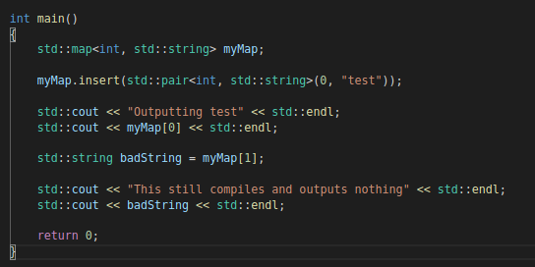
std::map example

Slide 6
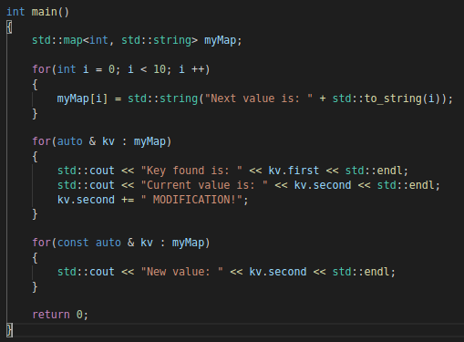
Iterating through a map
In C++ 11, we have the ranged based for loop available.
Iterating through a map is easy enough, but there are a few nuances to the iteration.

Slide 7
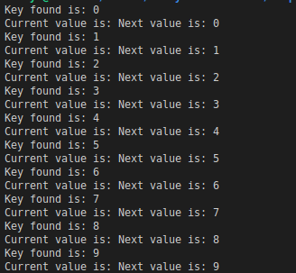
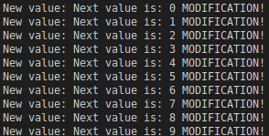
Iteration output

Slide 8
std::map::find(key)
std::map::find(key) -> std::map::iterator
What is an iterator?
Its basically a pointer to some node within the array.
You can compare them, or reference the key / value of that node.
There are two special iterators:
std::map::beginning()
std::map::end()
We will use these to implement some code to find keys within the map.

Slide 9
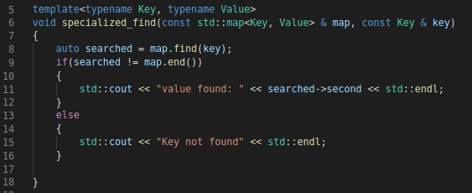
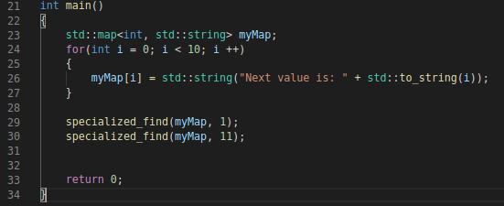

std::map::find

Slide 10
std::map complexity
Since the std::map is based on an RB Tree, log(n) is maintained for all its major operations

Slide 11
Use case for a map
Any time you have a specific UID for a “thing” that you have to constantly look up within a structure, consider using a map and having that UID be your key for the lookup.
There are other specialized implementations of a map to keep in mind as well:
multi_map: removes the 1 key allowed rule
unordered_map: provides a hash-table implementation instead of an RB tree: O(1) lookup and insert, dependent on your hashing.

